Slide 1

BHARATI VIDYAPEETH
(DEEMED TO BE UNIVERSITY)
COLLEGE OF ENGINEERING,PUNE.
DEPARTMENT OF COMPUTER ENGINEERING
HAND GESTURE CONTROL
Under the guidance of
“Mrs. Netra Patil”

Slide 2
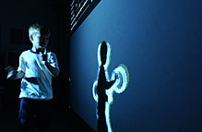
What is Gesture recognition?
Gesture recognition is a topic in computer science and language technology with the goal of interpreting human gestures via mathematical algorithms.
Gestures can originate from any bodily motion or state but commonly originate from the face or hand.
Our Project focuses on the recognition of hand gestures.
Users can use simple gestures to control or interact with devices without physically touching them.

Slide 3
Concepts Used:
Computer Vision
Artificial & Convolutional Neural Network
YOLOV3 (Darknet)
Flask
Android / Browser Interface

Slide 4
Approach
Gathering data
Preparing that data
Choosing a model
Training
Evaluation
Hyper parameter tuning
Prediction
Establishing Connection With Flask Server
Send Resultant to Target Application
Execute Desired Function

Slide 5
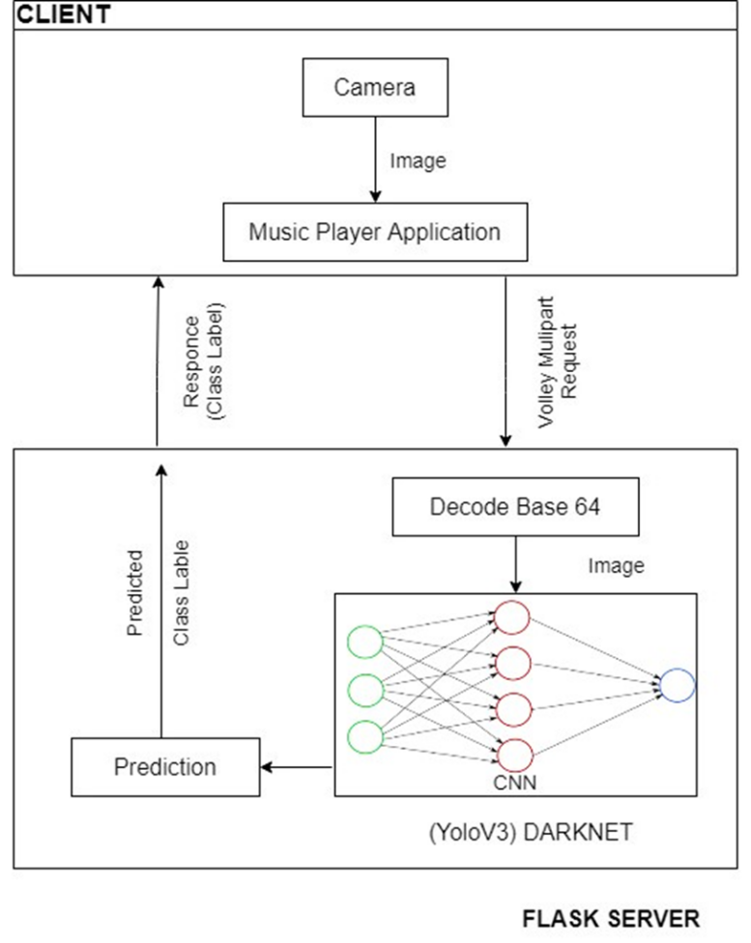
System Architecture

Slide 6
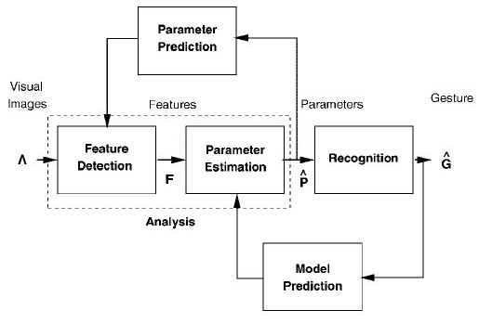
Working

Slide 7
Darknet framework
Darknet is an open source neural network framework written in C and CUDA.
It is actually a complete neural network framework, so it really can be used for other objectives besides YOLO detection.
All these implementations come “ready to use”, which means you only need to download and install them to start detecting images or videos right away using already trained weights.

Slide 8
YOLO
YOU ONLY LOOK ONCE.
The R-CNN family of techniques primarily use regions to localize the objects within the image. The network does not look at the entire image, only at the parts of the images which have a higher chance of containing an object.
The YOLO framework (You Only Look Once) on the other hand, deals with object detection in a different way. It takes the entire image in a single instance and predicts the bounding box coordinates and class probabilities for these boxes.
The biggest advantage of using YOLO is its superb speed – it’s incredibly fast and can process 45 frames per second. YOLO also understands generalized object representation.
YOLO trains on full images and directly optimizes detection performance.
Second, YOLO reasons globally about the image when making predictions.

Slide 9
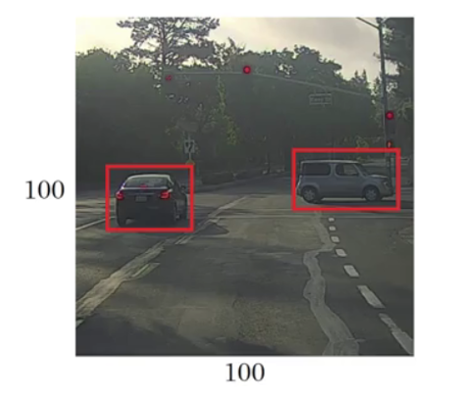
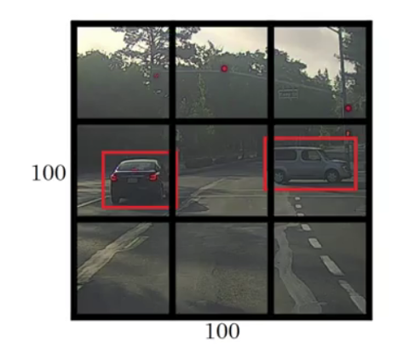
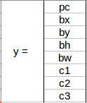
YOLO

Slide 10
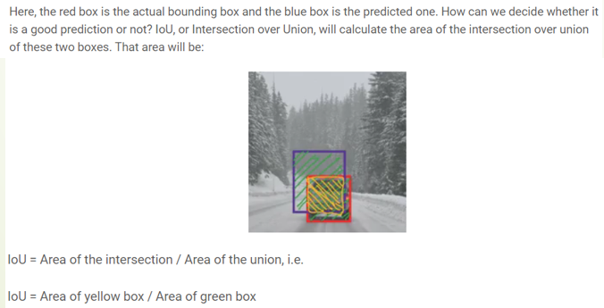
Intersection over Union

Slide 11
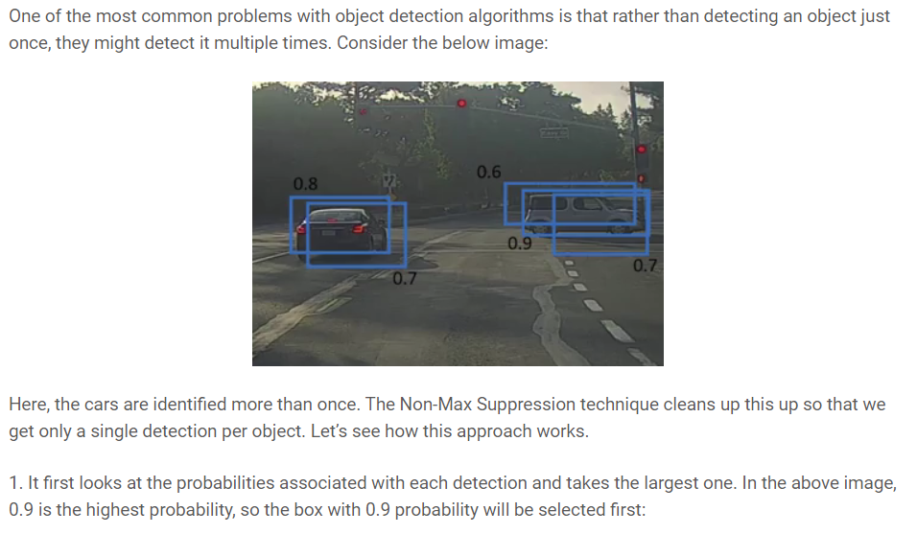
Non-Max Suppression

Slide 12
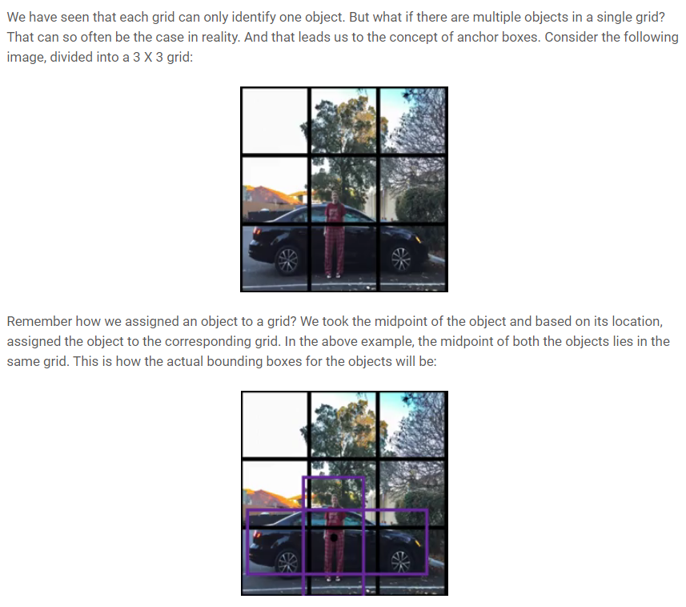
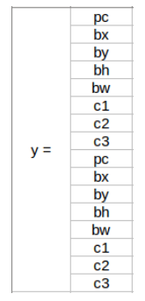
Anchor Boxes

Slide 13
Control Flow
Captured image
Application
Camera
VolleyMultiPart lib
Flask Sever
PerformDectect()
Darknet (YoloV3)
Jsonify
(String caption)
Python dictionary
Gesture Recognition
Performs
Application
Flask Server

Slide 14
What is Flask?
Android app uses VolleyMultipart lib. to post the image to the flask server.
The image is encoded in Base64 before sending.
Flask server receives the encoded image and decodes it.
Flask server calls performDetect() from darknet framework.
The function returns dictionary containing:
Caption : “ class label” Class label = { Play, Pause, Forward, Previous}
Flask server jsonify’s the class label and returns it to the Android app.
If class label==NULL, then it returns “no dectection”.
Notes:
. WSGI is a specification for a universal interface between the web server and the web applications.
It is a WSGI toolkit, which implements requests, response objects, and other utility functions. This enables building a web framework on top of it. The Flask framework uses Werkzeug as one of its bases.

Slide 15
User Interface
Capture Image By Accessing Camera.
Preprocessing of the captured image.
Sending the image over the network to the Flask Server.
Recieve the predicted caption from the Server.
Call the desired function which coressponds to the detection.
Interface can be developed on any platform : Android , Web Browser , Visual Basic etc.

Slide 16
ThankYou

